Slide 1


Sri Adichunchanagiri Shikshana Trust(R) S J B Institute of Technology
Department of Electronics & Communication Engineering
A project on
Conversion of sign language into audio and text
Review - I
By
BATCH NO.37
Student’s name [USN]
B Shamanth Kowshik 1JB17EC081
Uday KV 1JB17EC096
Under the guidance of
Mrs. Supriya M External guide
Assistant Professor, ECE, SJBIT

Slide 2
Objectives
The inability of normal people(who don’t understand sign language) to comprehend sign language gestures results in a communication barrier between normal and hearing and speech impaired people.
The project aims to bridge the communication gap by developing an effective gadget that converts sign-language gestures into audio and textual form providing quick information exchange.

Slide 3
Introduction
Sign language is a means of communication for the acoustically disabled individuals , which involves simultaneous use of facial expressions , orientation and movement of hand , finger spellings , body language , head movement and eye gazes in order to effectively convey the message and thought of a person.
Even with usage of sign language , hearing and speech impaired people would face a lot of difficulties in communicating their thoughts and ideas , especially to those who have meager or no knowledge of sign language.

Slide 4
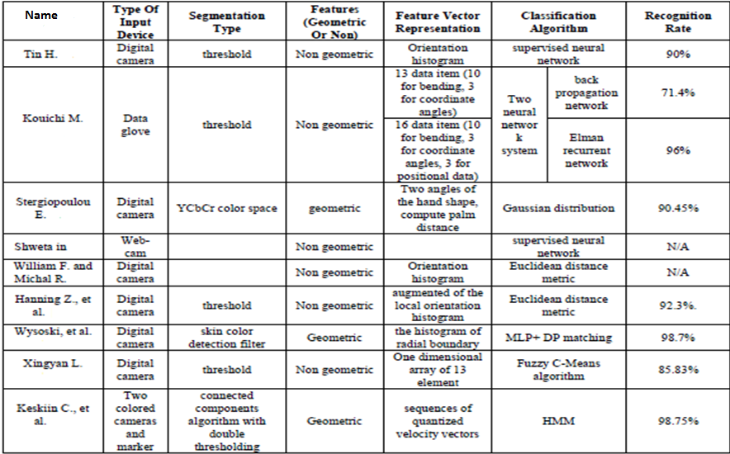
Literature Survey

Slide 5
Literature Survey- Paper 1
This paper was written Taner Arsan and Oğuz Ülgen on sign language converter in the year 2015.
The algorithm involves Database, Voice Recognition Procedure, Motion Capture Procedure.
This paper is about a system can support the communication between deaf and ordinary people. The aim of the study is to provide a complete dialog without knowing sign language.

Slide 6
The program has two parts. Firstly, the voice recognition part uses speech processing methods.
It takes the acoustic voice signal and converts it to a digital signal in computer and then show to the user the gif images as outcome.
Secondly, the motion recognition part uses image processing methods.
It uses Microsoft Kinect sensor and then give to the user the outcome as voice.

Slide 7
Literature Survey - Paper 2
This paper was written by Satya Prakash, Kapil Kumar Ahuja, Rahul Thakur, Vamsi Krishna regarding Sign Language Translator for Speech-impaired in the yaer 2019.
The Algorithm involves Rule Based Classifier, Background subtraction method by detecting the colour of skin using HSV (Hue Saturation Value) model.

Slide 8
The main objective was to translate sign language to text/speech.
The framework provides a helping-hand for speech-impaired to communicate with the rest of the world using sign language.
This leads to the elimination of the middle person who generally acts as a medium of translation.
This would contain a user-friendly environment for the user by providing speech/text output for a sign gesture input.

Slide 9
Literature Survey :- Paper 3
This paper was published by Mahesh Kumar N B on Conversion of sign language into text in 2018.
The project is mainly glove based and vision based approaches.
This research work has focused mainly on the recognition of static signs of ISL from images or video sequences that have been recorded under controlled conditions.
By using LDA algorithm for sign recognition operation the dimensionality will be reduced.

Slide 10
Continued
Due to dimensionality reduction the noise will be reduced and with high accuracy.
In future this project will be enhanced by determining the numbers which will be shown in words.

Slide 11
Possible Outcomes
This project is a small step towards helping a physically challenged people and lot more can be done to make the product more sophisticated, user friendly & efficient.
Using more memory and powerful microprocessor, more languages can be covered.
This project can be modified to make it compatible with mobile phones.
We can increase the range of product by using more powerful trans-receiver module.

Slide 12
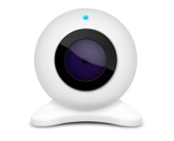

Block Diagram
Sign Language
Web camera
FPGA
LCD display screen
Speaker

Slide 13
System level block diagram
Image Acquisition
Color Conversion
Segmentation
Erosion
Dilation
Display
Centroid
Matlab Function

Slide 14
Flowchart
Captures gestures in video form
Color conversion
Segmentation
Erosion/Dilation
Feature Extraction
Matched
Comparison
Identification of hand w.r.t head
Centriod determination of hands and head
Display of message
Delimiters
Gesture Detection

Slide 15
Webcam and Data Glove
A webcam is a video camera that feeds or streams its image in real time to or through a computer or computer network.
There are huge number of advanced data gloves available for human computer interaction (HCI) today. A few of those which can be used for our project is mentioned below:-
MIT Data Glove :- From its developments in early 1980s, MIT Data Glove has evolved dramatically offering different capabilities with different models.

Slide 16
Data Glove
Currently developed under MIT spinoff company AnthroTronix, acceleGlove as shown in Fig. 2.3, is a user programmable glove that records hand and finger movements in 3D.
The other models available from them include 5DT’s Data Glove for virtual reality that cost between $1000–$5000.

Slide 17
Data Glove
CyberGlove III :- The CyberGlove III (MoCap Glove) developed by CyberGlove Systems is a device that aims to record gestures accurately for motion capturing for movie making and graphic animation industry as shown in the figure below.
The streamlined industrial designs that they developed allows for rigorous physical mobility in hand motion capturing for motion movies and graphic animation industry today.

Slide 18
Data Glove
Fifth Dimension Sensor Glove Ultra :- The 5DT Data Glove Ultra is another glove based gesture recognition device with very high precision flexor resolution.
With its arrays of sensors, it provides 10-bit flexor resolution which is aimed at highly natural motion capture for movie industry.
5DT Motion Capture Glove and Sensor Glove Ultra. (left) Current version, (right) early version

Slide 19
Data Glove
P5 Glove :- P5 Glove has been developed by MindFlux as a way to provide cheaper alternative to many expensive wired gloves available in the market that can be used for gaming.
The P5, as shown in figure below, incorporates a bend sensor and remote tracking technologies, which provides users intuitive interaction with 3D and virtual environments, such as games, websites and educational software.
P5 Glove—a cheaper alternative.

Slide 20
Gesture Recognition Techniques
The recognition of gesture involves several concepts such as pattern recognition, motion detection and analysis, and machine learning.
Different types of gesture recognition techniques used are:-
Artificial Neural Networks (ANN) :- The use of neural networks for gesture recognition has been examined by many researchers.
Most of the researches use ANN as a classifier in gesture recognition process, while some others use it to extract the shape of the hand, as in .
Histogram Based Feature :- Many researches have been applied based the histogram, where the orientation histogram is used as a feature vector.
The first implementation of the orientation histogram in gesture recognition system and real time was done by William F. and Michal R.

Slide 21
Gesture Recognition Techniques
Fuzzy Clustering Algorithm :-Clustering algorithms is a general term comprises all methods that partitioning the given set of sample data into subsets or clusters based on some measures between grouped elements.
According to this measure the pattern that share the same characteristics are grouped together to form a cluster.

Slide 22
References
[1] Wikipedia. Sign Language, 2012. http://en.wikipedia.org/wiki/Sign_language, accessed Feb. 2012.
[2] P. Boyes Braem. Einführung in die Gebärdensprache und ihre Erforschung (Introduction to sign language and its study). Signum, Hamburg, Ger., 1995.
[3] S. Prillwitz, R. Leven, H. Zienert, T. Hanke, and J. Henning. Hamburg Notation System for Sign Languages – An Introductory Guide. Institute of German Sign Language and Communication of the Deaf, University of Hamburg, Hamburg, Ger., 1989.
[4]Wikipedia.File:Aslfingerspellalpha,2011. http://en.wikipedia.org/wiki/File:Aslfingerspellalpha.png, accessed Apr. 2012.
[5]Wikipedia,AmericanSignLanguage,2012. http://en.wikipedia.org/wiki/American_Sign_Language, accessed Jan. 2012.
[6] B. Vicars. Basic Signs Pictures, n.d. http://www.lifeprint.com/asl101/pages-layout/concepts.htm, accessed Dec. 2011.
[7] Wikipedia. IMAGE PROCESSING, http://en.wikipedia.org/wiki/Image_processing
[8] Wikipedia. RGB COLOR MODEL, http://en.wikipedia.org/wiki/Color_model
[9] Wikipedia. CAMERA, http://en.wikipedia.org/wiki/Camera
[10] Noor Adnan Ibraheem Department of Computer Science A.M.U., Aligarh Uttar Pradesh, India. Survey on Various Gesture Recognition Technologies and Techniques. Volume 50 – No.7, July 2012

Slide 23
Thank You
Have a Wonderful and safe day ☺

